Slide 1
Classification of Video for Action Recognition
Venkatesh Babu
Sreevatsan A

Slide 2
Introduction
Overview
Recognizing activities in videos has become a hot topic over the last years due to the continuous increase of video cameras devices and online repositories. This large amount of data requires an automatic indexing to be accessed after capture. The recent advances in video coding, storage and computational resources have boosted research in the field towards new and more efficient solutions for organizing and retrieving video content.
In this project we will use CNN to extract the feature and RNN for sequence to sequence classification.
Goal
The main goal is to observe and analyse human activities and to interpret ongoing events successfully. This is done by obtaining the probabilities of the activity for the whole video as the mean of each activity output through the whole video sequence.

Slide 3
Data Set
UCF101 is an action recognition data set of realistic action videos, collected from YouTube
Link: http://crcv.ucf.edu/data/UCF101.php
Data contains:
101 action categories
13320 videos
Data Pre-processing:
We split the data into training, testing and validation data set
Training Data = 8596 videos
Testing Data = 1706 videos
Validation Data = 1712 videos
Using ffmpeg we converted all the videos into frames
Saved all the frames in the .jpg file format in the respective folders
Wrote the video file name and number of frames generated into CSV

Slide 4
Type of Approach's
Type of Approach:
Approach 1: Using Image
Approach 1: Using Features
Approach 1 - Model 1: LRCN
Steps to Follow:
We gathered all the .jpg file related to the videos
We rescaled the list of .jpg file in such away we get a same number of image for all the videos
Build the image sequence with the rescaled list of images
Build deep learning model with lrcn
Save the model in a .json file format so we can use it for later purpose
Save the model weight in .HDF5 format so we can use it for later purpose

Slide 5
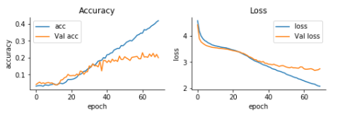
Approach 1 - Model 1: LRCN
Built a 10-layer convolution 2D layer
Activation function used Relu and SoftMax
We are using loss as categorical_crossentropy and optimizer Adam
Test loss: 2.7
Test accuracy: 0.21
Graph – (Accuracy and Loss)

Slide 6
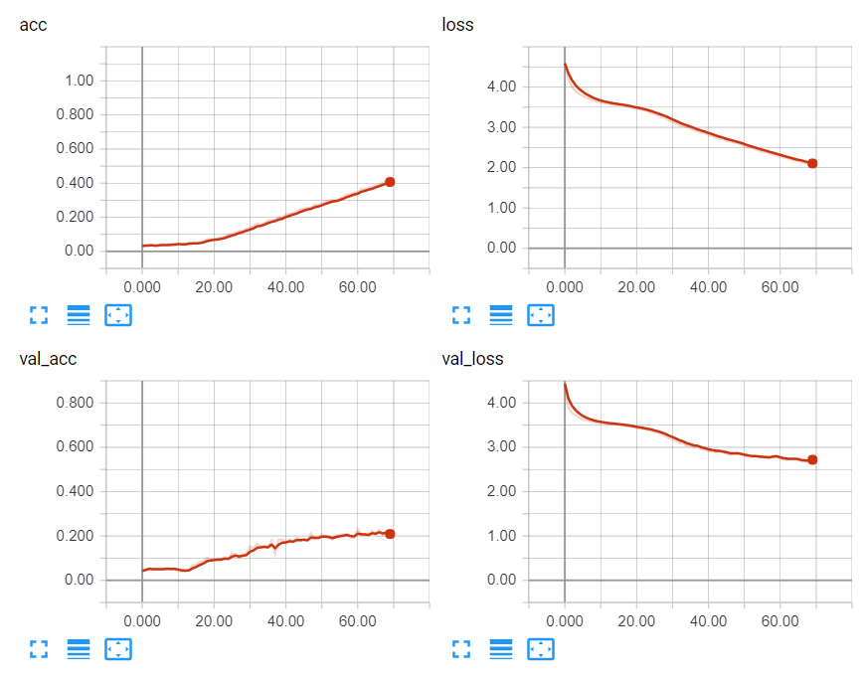
Approach 1 - Model 1: LRCN
Graph – (Accuracy and Loss) from TensorBoard

Slide 7
Approach 2: Using Features ( CNN )
Steps to Follow:
We downloaded the Inception model with pretrained weights using InceptionV3 package
We gathered all the .jpg file related to the videos
We rescaled the list of .jpg file in such away we get a same number of image for all the videos
Using the inception model we extracted the feature of each image and combine then into a sequence of feature and saved then in .npy file format
One hot encode the final Y test and train

Slide 8
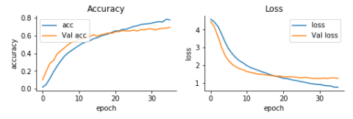
Approach 2 - Model 1: CNN - LSTM
Built a 3 -layer model with 0.5 percent dropout
Activation function used Relu and SoftMax
We are using loss as categorical_crossentropy and optimizer Adam
Test loss: 1.21
Test accuracy: 0.70
Graph – (Accuracy and Loss)

Slide 9
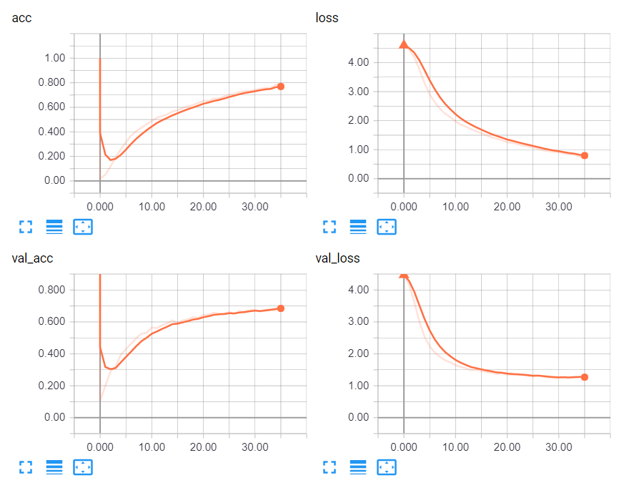
Approach 2 - Model 1: CNN - LSTM
Graph – (Accuracy and Loss) from TensorBoard

Slide 10
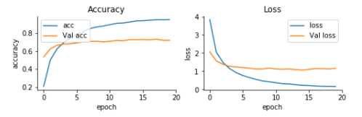
Approach 2 - Model 2: CNN - MLP
Built a 2-layer dense model with 0.5 percent dropout
Activation function used Relu and SoftMax
We are using loss as categorical_crossentropy and optimizer Adam
Test loss: 1.14
Test accuracy: 0.72
Graph – (Accuracy and Loss)

Slide 11
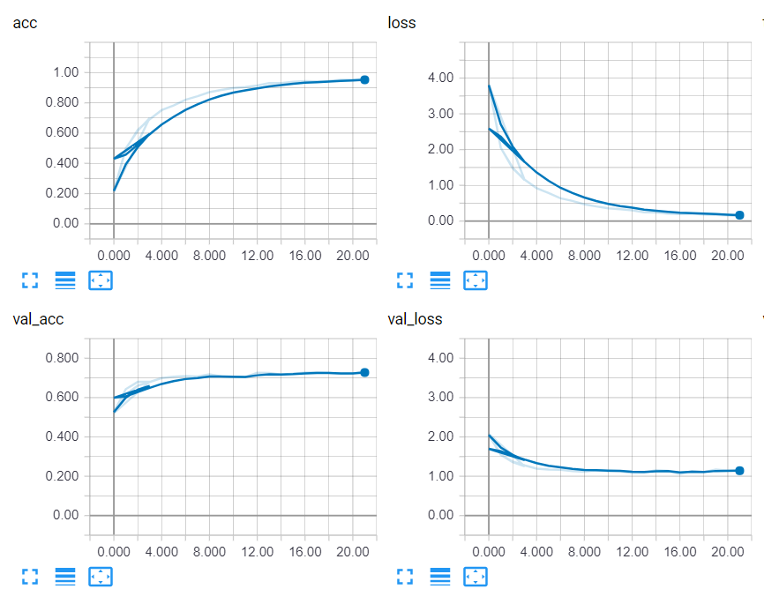
Approach 2 - Model 2: CNN - MLP
Graph – (Accuracy and Loss) formTensorBoard

Slide 12
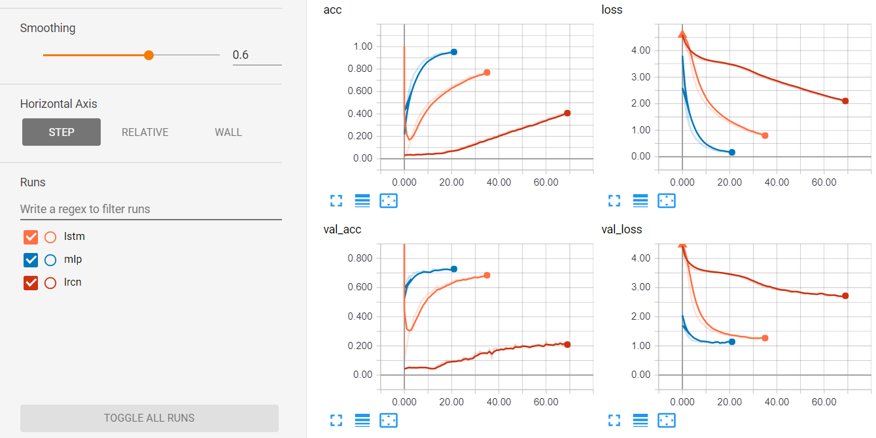
Conclusion
From the accuracy of the above built model we can say CNN - MLP is the best of all the model with 72 percent accuracy
Model | Loss | Accuracy
CNN - MLP | 1.14 | 72
CNN - LSTM | 1.21 | 70
LRCN | 2.7 | 21

